Slide 1
UNIT 2.part II. JAVA CONNECTORS FOR DATABASES.jdbc

Slide 2
index
ExecuteUpdate: insert, update, delete
ExecuteUpdate: create, alter, drop table
PreparedStatements
CallabelObjects

Slide 3
Links
https://www.tutorialspoint.com/jdbc/index.htm
http://www.informit.com/articles/article.aspx?p=26251&seqNum=3
https://www.studytonight.com/java/steps-to-connect-to-database-in-java.php
https://www.studytonight.com/java/connecting-to-mysql.php
https://www.javatpoint.com/Connection-interface

Slide 4
1. modifiying a database
We can modify a database from our application.
First we need to have a connection to the database
Second, we can use de method executeUpdate( ) if we want to:
INSERT
UPDATE
DELETE
We can also modify the structure of tables (DDL):
CREATE new TABLES,
DROP tables
ALTER tables

Slide 5
Method Statement.ExecuteUpdate( )
https://docs.oracle.com/javase/7/docs/api/java/sql/Statement.html
The class Statement has the method executeUpdate:
int executeUpdate(String sqlSentence): Runs the given SQL statement, which can be an INSERT, UPDATE, or DELETE statement; or an SQL statement that returns nothing, such as an SQL DDL statement.
it affects the database of a connection and returns the number of rows affected by the SQL sentence or 0 if it is a DDL sentence.

Slide 6
Example: inser, update, delete in oracle db
import java.sql.*;
class FetchRecord{
public static void main(String args[])throws Exception{
Class.forName("oracle.jdbc.driver.OracleDriver");
Connection con=DriverManager.getConnection("jdbc:oracle:thin:@localhost:1521:xe","system","oracle");
Statement stmt=con.createStatement();
//stmt.executeUpdate("insert into emp765 values(33,'Irfan',50000)");
//int result=stmt.executeUpdate("update emp765 set name='Vimal',salary=10000 where id=33");
int result=stmt.executeUpdate("delete from emp765 where id=33");
System.out.println(result+" records affected");
con.close();
}}

Slide 7
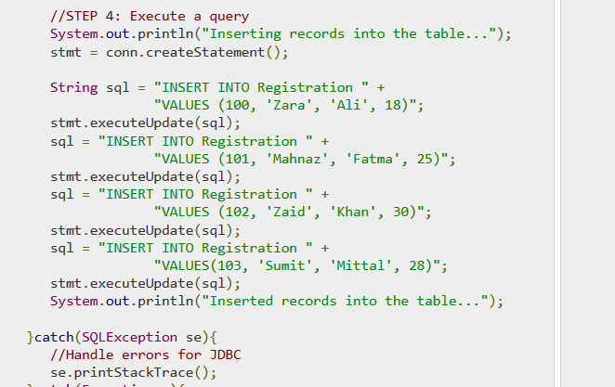
Jdbc insert
https://www.tutorialspoint.com/jdbc/jdbc-insert-records.htm

Slide 8
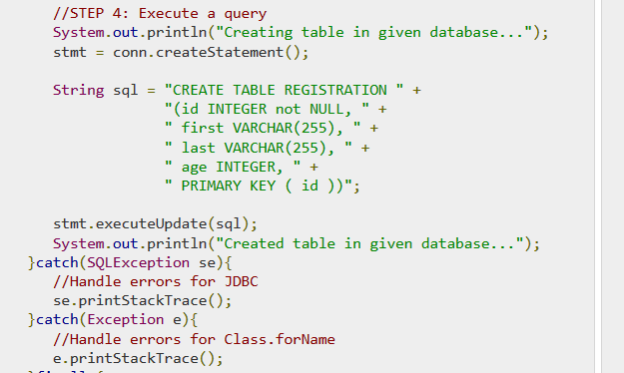
2. Jdbc: create, alter, drop table
https://www.tutorialspoint.com/jdbc/jdbc-create-tables.htm

Slide 9
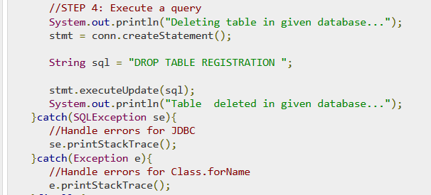
https://www.tutorialspoint.com/jdbc/jdbc-drop-tables.htm

Slide 10
Practice 2.2: insert, update, delete in a database

Slide 11
3. Prepared statements
https://www.tutorialspoint.com/jdbc/jdbc-statements.htm
The PreparedStatement interface extends the Statement interface, which gives you added functionality with a couple of advantages over a generic Statement object.
This statement gives you the flexibility of supplying arguments dynamically.
EXAMPLE:
https://www.tutorialspoint.com/jdbc/preparestatement-object-example.htm

Slide 12
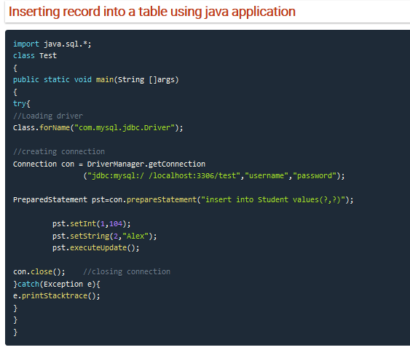

Slide 13
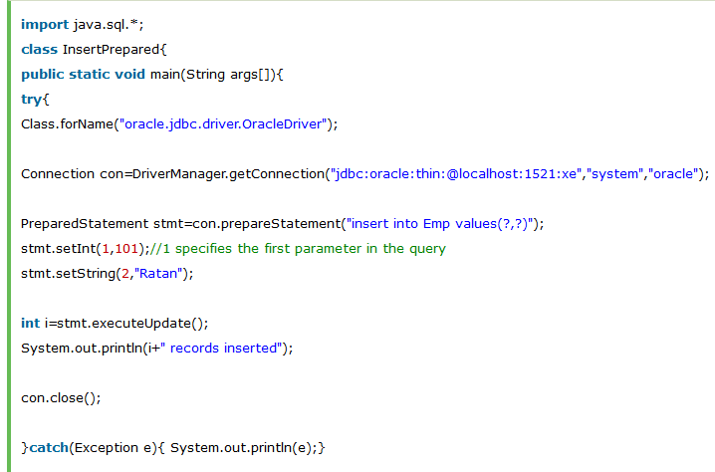
https://www.javatpoint.com/PreparedStatement-interface

Slide 14
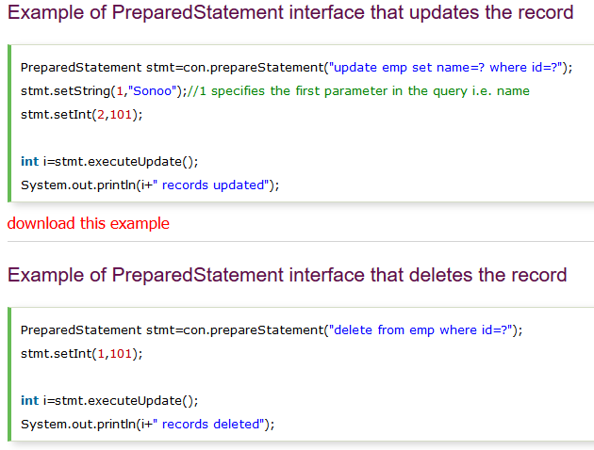

Slide 15
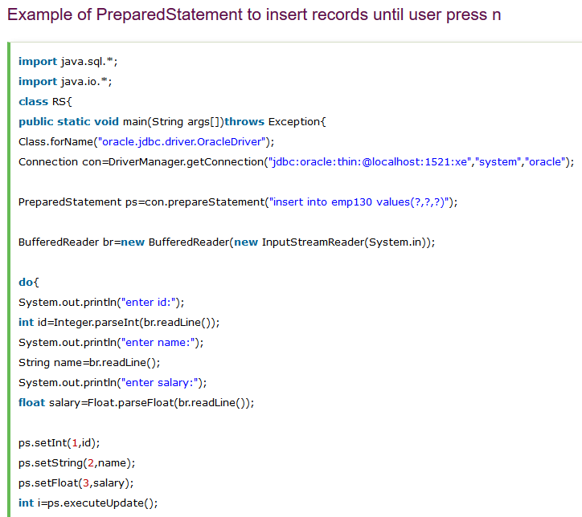

Slide 16
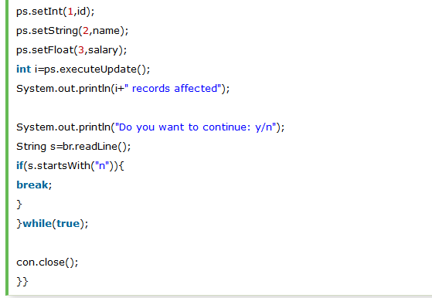

Slide 17
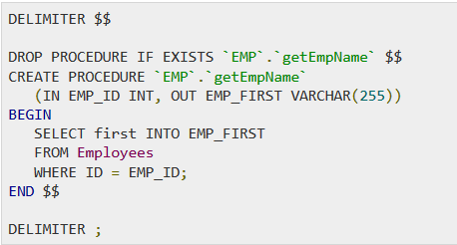
4. The CallableStatement Objects
CallableStatement is used to execute a call to a stored procedure in the database.
Example: we have this procedure

Slide 18
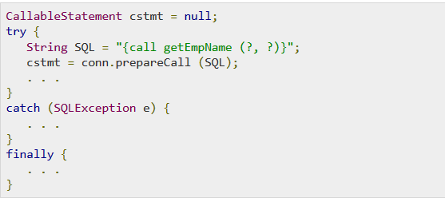
Callable objects
We will use code like this: (CallableStatement, method prepareCall(sql)

Slide 19
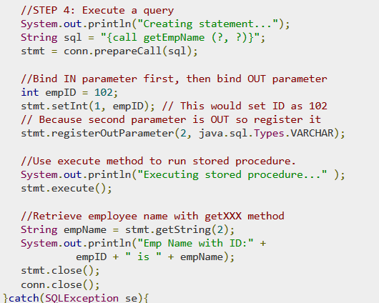
Example callable objects:
https://www.tutorialspoint.com/jdbc/callablestatement-object-example.htm

Slide 20
https://www.adictosaltrabajo.com/2011/08/04/usando-callable-statements-to-execute-stored-procedure/
https://www.ibm.com/support/knowledgecenter/es/ssw_ibm_i_71/rzaha/callable.htm

